Slide 1
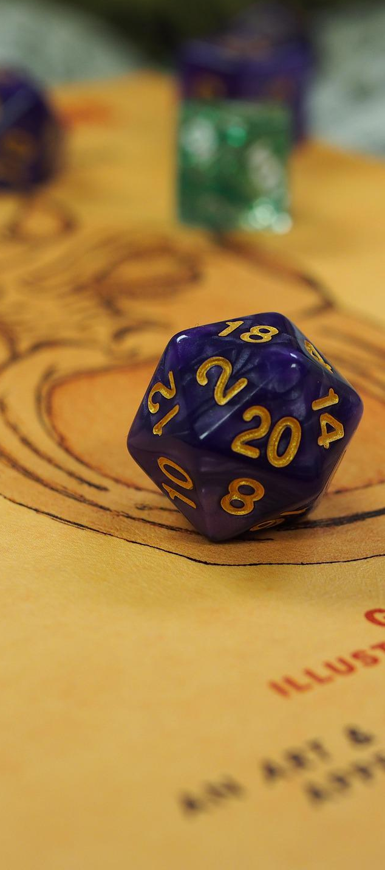


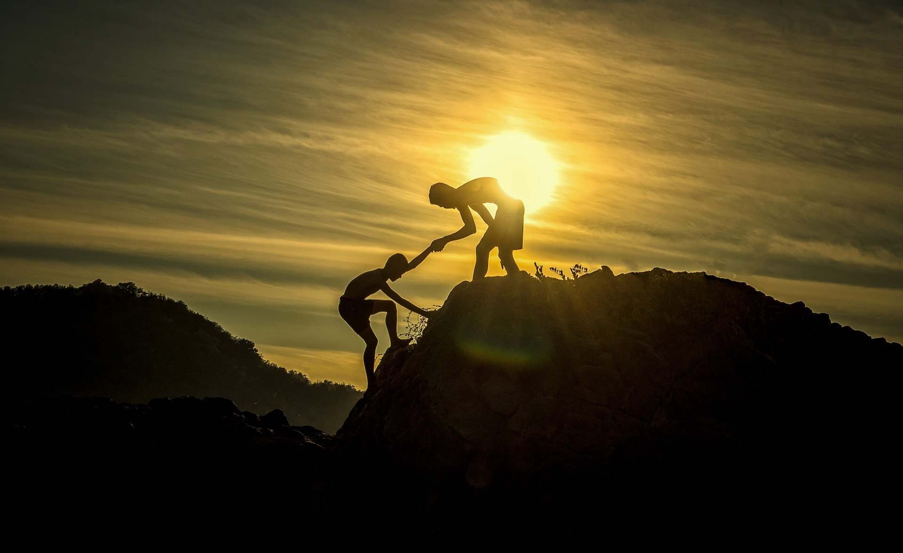
Tabletop Role-playing Games at Work for Fun & Profit
Stacy Vicknair | Christine Assaf | William Assaf

Slide 2

Innovation with Empathy
“Innovation comes from having a deep sense of empathy.”
Satya Nadella
Notes:
<william>
I’d like to get us started today talking about something you might not have expected us to talk about today.
Empathy.
Empathy has a role in both playing games as well as business. I don’t mean empathy like Deanna Troi in Star Trek, I mean empathy as in the ability to think like someone else, to make your observations as if you had the qualities of another individual. The old metaphor of walking a mile in someone else’s shoes.
Empathy is important.
In a roleplaying game, I might play and experience a world in which I am oppressed minority, or the leader of a great group of adventurers, or finding myself a stranger in a strange land.
Microsoft CEO Satya Nadella has made empathy a part of Microsoft’s business, associating empathy with innovation, himself:
“Innovation comes from having a deep sense of empathy.”
[Christine] Daniel Goleman psychologist who wrote the 1995 book Emotional Intelligence. He’s kind of the godfather of EI. The 5 skill sets of EI are self-awareness, self-control, motivation, interpersonal skills and empathy. Empathy being the ability to read and recognize the emotions of of others and responding to them appropriately. and Dr. Goleman said in an HBR interview says that EI is "self-mastered" – it can be learned; through education and practice a person can learn empathy and the other EI skills.
And that's really what we're here to discuss: how you can learn and practice the tools to build empathy and other business skills in inside of a TTRPG.
<click>

Slide 3
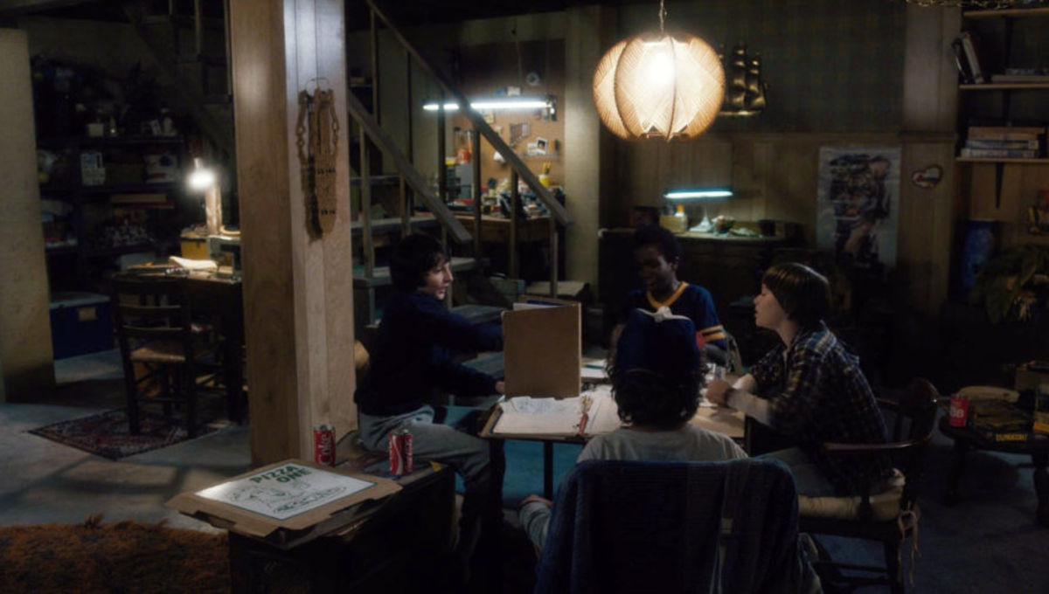
What is a tabletop role-playing game (TTRPG)?
Notes:
<william>
So what is a TTRPG?
At their most basic level, TTRPGs bring people together to improvise a story. You've probably seen photos like this one before. These are characters from Netflix's Stranger Things playing Dungeons and Dragons, and while usually table-top roleplaying games take place at a literal table-top, these days we play it online with a virtual table-top.
There are two roles people play within the group: the Players, <click> and the Dungeon Master <click> (also known as the Game Master or GM, but here we’ll use the phrase Dungeon Master).
In this image, the Dungeon Master has a book propped up in front of them and many resources they're using to help tell a story, and all the players have a paper in front of them to keep track of information about their character.
<click>

Slide 4
Roles in a TTRPG
Player
Dungeon Master
One of the main characters.
Has agency in a sandbox.
Doesn’t know what’s next.
Makes decisions “in character” based on “character knowledge” not player knowledge.
Co-creates the world and plot.
Improvises within fictional world.
Helps tell the story.
All other characters in the world.
Manages the sandbox.
Prepares for what could be next.
Makes decisions consistently, based on knowledge of the world and events to come.
Co-creates the world and plot.
Improvises within fictional world.
Helps tell the story.
Notes:
<william>
But more specifically, here’s a quick breakdown so that if you’re new to the concept of a table top role playing game, you get the basics.
<click>
Each human player has the one responsibility of playing one character in the world. These are the “main characters” of the story, <click>
they have agency in the sandbox of the world, <click>
and while they don’t know what happens next in the story, they have a large degree of freedom to make decisions in this fictional world. <click>
They make decisions by playing the role of character, and because it’s fun, players often separate their “character’s” knowledge from their own player knowledge for some situational irony and often comedy.
On the other hand, the Dungeon Master has more responsibilities: <click>
They run the entire world and all its other non-player characters and <click>
manage the goings on of the sandbox and its plot,<click>
prepare for the many possible decisions the players could make, <click>
and make decisions consistently about rules and story.
The Dungeon Master is a referee in some cases, but not necessarily an adversary or opponent, though Dungeon Master does play as the enemies of the player in combat situations.
The Dungeon Master has an idea of the fictional world in their mind, and they create mysteries, monsters, and marvels throughout the world. But the Dungeon Master doesn’t do this alone. <click>
Since the player’s characters have their own agency, the Dungeon Master must balance their storytelling job with refereeing. Both roles co-create in the world. <click>
If a player does something unexpected, what happens next? Both roles improvise within the fictional world.
The Dungeon Master is tasked with both enabling creativity and cooperation, as well as providing the challenges, but everyone in the world helps tell the story. <click>
Everyone at the table works together to design goals, to agree on and follow rules, and to provide the psychological safety that fosters innovation and fun.
And as we’ll discuss today, everyone can benefit from a continuous improvement of their communication and improvisation and empathy through table-top roleplaying games.

Slide 5
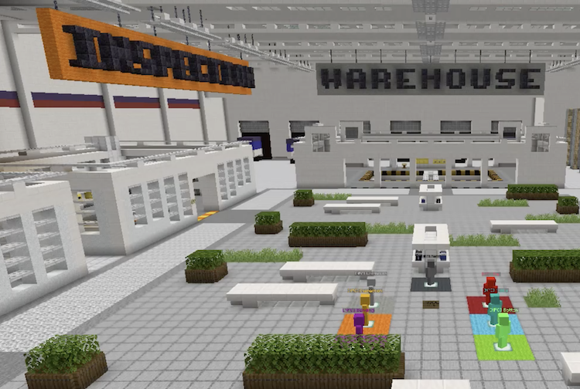

Can you build skills through playing a game?
We learn better when we’re having fun!
2. Skills are transferrable!
Notes:
[Christine]
Just as I mentioned earlier with Goleman and EI - The short answer is Yes! In fact, we learn better that way.
In instructional design, years of research have shown us that adult learners learn best when
they set their own goals and have self-direction.
Enjoy the learning
Are problem solving
And see the training as applicable.
In fact, we learn better when we’re having fun. Motivation and self-efficacy (an person’s belief that they can do that thing) are integral to learning and skill development.
Organizations and Training & Development professionals, such as myself, are constantly trying to find creative and fun ways to skill develop.
Pepsico took it’s Lean Six Sigma training to Minecraft to both solve virtual training but also because it created a place of curiosity and innovation.
Walmart launched a VR training program in 2018 regionally. Not only did this solve regional training issues they faced, but it also gave a self-paced way of learning.
Secondly, skills are transferrable. Many of you may have hobbies – fishing, or knitting, or painting. In a study from 2014, Org Pyschs studied a group of workers who had hobbies and a group who didn’t’s and they noted a significant different in recovery experiences (i.e., mastery, control, and relaxation) and performance-related outcomes (i.e., job creativity and extra-role behaviors). We this tells us is that we tend to being all our skills to work, we’re not partitioned, what we learn personally can help us professionally

Slide 6

Professional Storytelling
Professional Communication | Teamwork | Team Management | Diversity | Practice Empathy | Q&A
Notes:
<christine>
While delivering presentations, as when playing a game with friends, you want to keep everyone engages and involved. Storytelling is universal, and everyone loves a good story.
Talking to you today are three experienced former Toastmasters in front of you, Stacy being by far the most accomplished here.

Slide 7
Preparing to Improvise
Prepare to deliver
Be humane
Practice, Practice, Practice
Know your audience
Notes:
<Christine>
As the Dungeon Master in a role playing game, the last thing you want to do is read monotonous, verbatim texts to your table, or to worse, come across as disorganized and disjointed. You want to seamlessly deliver descriptions of anything, even if you’re making them up on the fly.
<click>
As a professional communicator, much of the same applies. Organizations like Toastmasters provide ways to practice your professional communication and public speaking skills in a constructive environment.
But if that's not your thing, you can learn similar lessons through TTRPGs. As the Dungeon Master, by running a table and keeping everyone engaged, you're practicing similar skills that you need when running, say, an sales pitch or executive briefing.
What kind of skills can you learn then?
<click>
Bio-breaks every hour to be humane. Just because you can stand and filibuster for 3 hours straight, doesn’t mean they can listen that long.
For virtual arenas, video chat is extremely important. You're missing a lot of information without everyone being on video. Conference calls tends to favor those who already have the loudest voices or most powerful roles. The Teams hand-raise feature is an equalizer. It's an easy way to ensure everyone gets an opportunity to contribute, even when they can't compete for volume or intensity level.
<click>
Finally, you must always prep for your audience, and tailor your content and delivery to suit. At the gaming table, some players will be motivated by lots of political intrigue and role-playing, or maybe solving puzzles and riddles, while some are most into combat and looting treasure. Similarly, some folks in an executive brainstorming session or planning presentation are all about the bottom line, some are about building future-proof solutions, and some are about feature integrations.
In some conversations, for example, Sales/Ops, the sellers will be most concerned about closing deals and ops leadership will be more concerned about delivery, staffing. We need to know where everyone is coming from.
How can you make sure your pitch appeals to each?

Slide 8

Teamwork
Professional Communication | Teamwork | Team Management | Diversity | Practice Empathy | Q&A
Notes:
<Christine>
Being an engaging presenter is a valuable life, work, and gaming skill.
Running a gaming table as a game master helped me, and can help you to develop a comfort level with your own voice, improvisation skills, and ability to react to sudden redirections.
Most importantly, it gave me experience with preparation, both before the event with my notes, and organizing my thoughts right before I need to say them.

Slide 9
Teamwork & Leadership
Human Relations: communication, providing support, team building
Competitiveness & Control: focusing on achievement & results
Fostering Entrepreneurship & Innovation: encouraging creativity and autonomy
Order & Rationality: maintaining control
Notes:
<Christine>
Some I/O Psych researchers conducted a massive study of managers from over 150 organizations. And what they wanted to do here was identify the skills & competencies that make up a successful manager. And the results they got broke down to four basic clusters:
Human Relations: communication, providing support, team building
Competitiveness & Control: focusing on achievement & results
Fostering Entrepreneurship & Innovation: encouraging creativity and autonomy
Order & Rationality: maintaining control
Now what you may notice here, as the researchers did, that cluster 3 and cluster 4 are contradictory and paradoxical. Fostering innovation and entrepreneurships is the opposite of maintaining control. Yet, they discovered that successful leaders are those able to resolve this paradox. That even as they are maitning control and stability they are able to foster and encourage creativity and flexibility. And I can’t think of a better way to describe a DM at at TTRPG than a person who is maintaining control but encouraging creativity among their players. As well as the players at the table becoming comfortable with this dynamic, which in turn, gives them the skillset to operate comfortably in that state.

Slide 10
Veteran Leadership
Avoid knowledge bottlenecks
Tone and tenor, model behavior
Demonstrate freedom to innovate
Notes:
<Christine>
Here’s where we get into some of our favorite parallels between professional teamwork and cooperative storytelling at the gaming table.
<click>
First, Good teams combine veteran leadership with newcomers.
When playing a TTRPG, the Dungeon Master will easily become a bottleneck for new players. If new players can only ask the Dungeon Master about game rules, everyone suffers because the game slows down universally. But if veteran team members are present, willing, and ready to help newcomers, then the full load is taken off the Dungeon Master, and they can focus on guiding the story while veteran team members show new players the ropes.
On a dev team, a single PM or even a senior technical lead will become a bottleneck for questions and how-to's. It's better if more experienced members of the team, even if they aren't technical leads or principal architects, are able to walk devs through organizational processes, including codebases and architecture.
Team members might not feel comfortable asking "dumb" questions all the way up the chain, and would rather use a peer as a sounding board. Not to mention that this also saves the Manager and Dungeon Master a lot of time.
<click>
Veteran players help establish the accepted tone and tenor of the gaming table and the status meeting. They show not only how to roll the dice, but model behavior how to interact with the others, how to make requests, where to get the good coffee. That kind of info doesn't need to come from management, but regardless it's new players and team members still need to know it. But most importantly,
<click>
Veterans have the burden and the privilege to be exemplary, to demonstrate the freedom to be creative. That freedom is not something that everyone understands right away … teams should demonstrate empowerment to innovative, and build on each other’s successes.
Meanwhile, if you are in management or the Dungeon Master of a gaming table? Don’t you dare stand in the way - by laying down arduous rules, putting up walls to communication, or single threading the flow of information through yourself. That just makes more work for you, and less fun for everyone else.

Slide 11
Team Management
Professional Communication | Teamwork | Team Management | Diversity | Practice Empathy | Q&A
Notes:
<stacy>
In addition to veteran leadership amongst our team members there are also lessons we can draw from table top gaming into team management. You may not jump straight into leading a campaign if you're new to tabletop but here are some of the applicable skills that you can take from the table to the office.

Slide 12

Motivation
Creative work is intrinsically more motivating
Allow for autonomy and mastery
Help connect the team to the purpose
Notes:
<stacy> One of my favorite books about people leadership is Dan Pink's Drive. If you aren't familiar with it I highly recommend checking YouTube for the whiteboard animation of his presentation to the Renaissance Society of America. In Drive, Dan argues that for work that is heuristic, or creative, require intrinsic motivation more so than extrinsic motivation. The three factors of intrinsic motivation that he describes are autonomy, the ability to do the work the way we believe it should be done, mastery, the ability to continue to learn and grow, and purpose, to understand and believe in the purpose behind what we're doing.
These three intrinsic factors are necessary to be successful at the tabletop too. <click> If you were at a game of D&D and the Dungeon Master told you exactly what to do, which spells to cast, where to stand, and what to say, which spells to take when you level up, how boring would that be? Why does the DM even need you there if they are telling you what to do? The same goes for in the office. If, as a manager, you cannot delegate and allow for team members to take on those challenges then why even have them? How can you assume that how you do things is best for everyone? This also prevents the change for growth, limits the team member's ability for mastery. What's great about D&D is that mastery is baked in to the leveling system. That's not the only place where mastery occurs, though. It also occurs through the freedom to play your character and learn from those experiences. At this point in my career I'm smart enough to know that I'm too dumb to know everything. As a DM, or as a people manager, I try to speak last when collaborating to make sure that I'm not accidentally stifling a better opinion. This can be a real concern with folks who may be sensitive to positional authority. <click> What can really help us maintain autonomy and mastery within our teams is to focus on purpose and help our team align with and understand the purpose of our organization, product, or campaign. In D&D we may have some catalytic event that sets the stage for what motivates our team. In the office sometimes it's not so cut and dry, but what I like to do is try to draw a line to the human impact we have with the work we're doing. We also have to consider that team members (and our players) will bring their own motivation to the table as well. It's important to understand those motivations and help team members see them through. The great side affect of focusing on purpose is that it helps align team members so that, when given the proper autonomy, they are better able to make decisions that align with that purpose. <click>

Slide 13
You’re the Manager now, dog
The new employee experience
Progression is important
Priorities, from Low to High
First impressions are important.
Everyone should know what it takes to level up.
Maslow and all that.
Freedom to create.
Notes:
<stacy>
Whether you are team lead, a manager, or the Dungeon Master of a campaign, there are a lot of things we can do to help our team members have smooth onboarding, career progression, and top performance.
<click>
Joining a new company, there's so much to learn and do, onboarding can feel like an avalanche of information. Similarly, a player new to your table may feel an overload of new game system rules, lore, and backstory to consume. In each case, it can be overwhelming and dissuading. So, having reasonable expectations for new employees on your team or players in your game is important. Allow for time to onboard, and specifically make an effort to focus on onboarding for someone new. You don't want to screw up the first impression.
By the way, even before the hire, the candidate interview experience is also super important. If you interview someone for hours across multiple days and require a presentation and homework and watching a video and stuff, and then you don’t hire them, that doesn’t reflect well on you, certain rocket company who will remain unnamed. Similarly, you could easily turn off new players to your gaming table by coming across as haughty, unapproachable, super intense, or picky and critical. So, practice your pitch to newcomers... Both your employees and your players.
<click>
In careers as in player characters, understanding the ladder of progression is also important. Making sure newcomers know what it takes to get promoted or to level up, is part of rewarding and incentivizing the good behavior. Making sure players know how higher level characters grow is important as well. In each case, teammates should help each other grow and foster desirable growth attributes, so that the whole team advances together. Creating a competitive or cutthroat atmosphere in a team at work makes about as much sense as it does at the gaming table - it doesn’t. Can you imagine if players were constantly backstabbing each other? How would they ever slay the dragon?
<Christine’s study on training here>
<click>
Finally, Maslow's hierarchy of needs. For the unfamiliar: something that’s discussed in any management course, Maslow theorized that there's a hierarchy of basic human needs. If you want team members to succeed, you need to make sure their needs are met in the order of the hierarchy. The most basic physiological needs like food, water, shelter, sleep, etc., will always disrupt the highest order priorities… those that involve innovation and self-actualization. On that list is both physical and psychological safety … a sense of belonging - these are required before we can become our ideal selves, our ideal teammates, or our champion dragon hunters.
At work, this is why companies have benefits and competitive salaries, and an emphasis on work life balance. It’s why affordable housing is important, it’s why paid time off is necessary.
At the gaming table, sure we have snacks and comfortable chairs, but also, we value each player's freedom to be creative … without being made fun of. Freedom from infighting or harassment or unwelcome propositioning or teasing.
We'll talk more about the importance of psychological safety later, and why it is often taken for granted.

Slide 14
Diversity
Professional Communication | Teamwork | Team Management | Diversity | Practice Empathy | Q&A
Notes:
<william>
Diversity can make or break a team of co-workers or co-adventurers. A diverse set of backgrounds, experience, and skills make for a balanced team that can overcome great challenges.

Slide 15
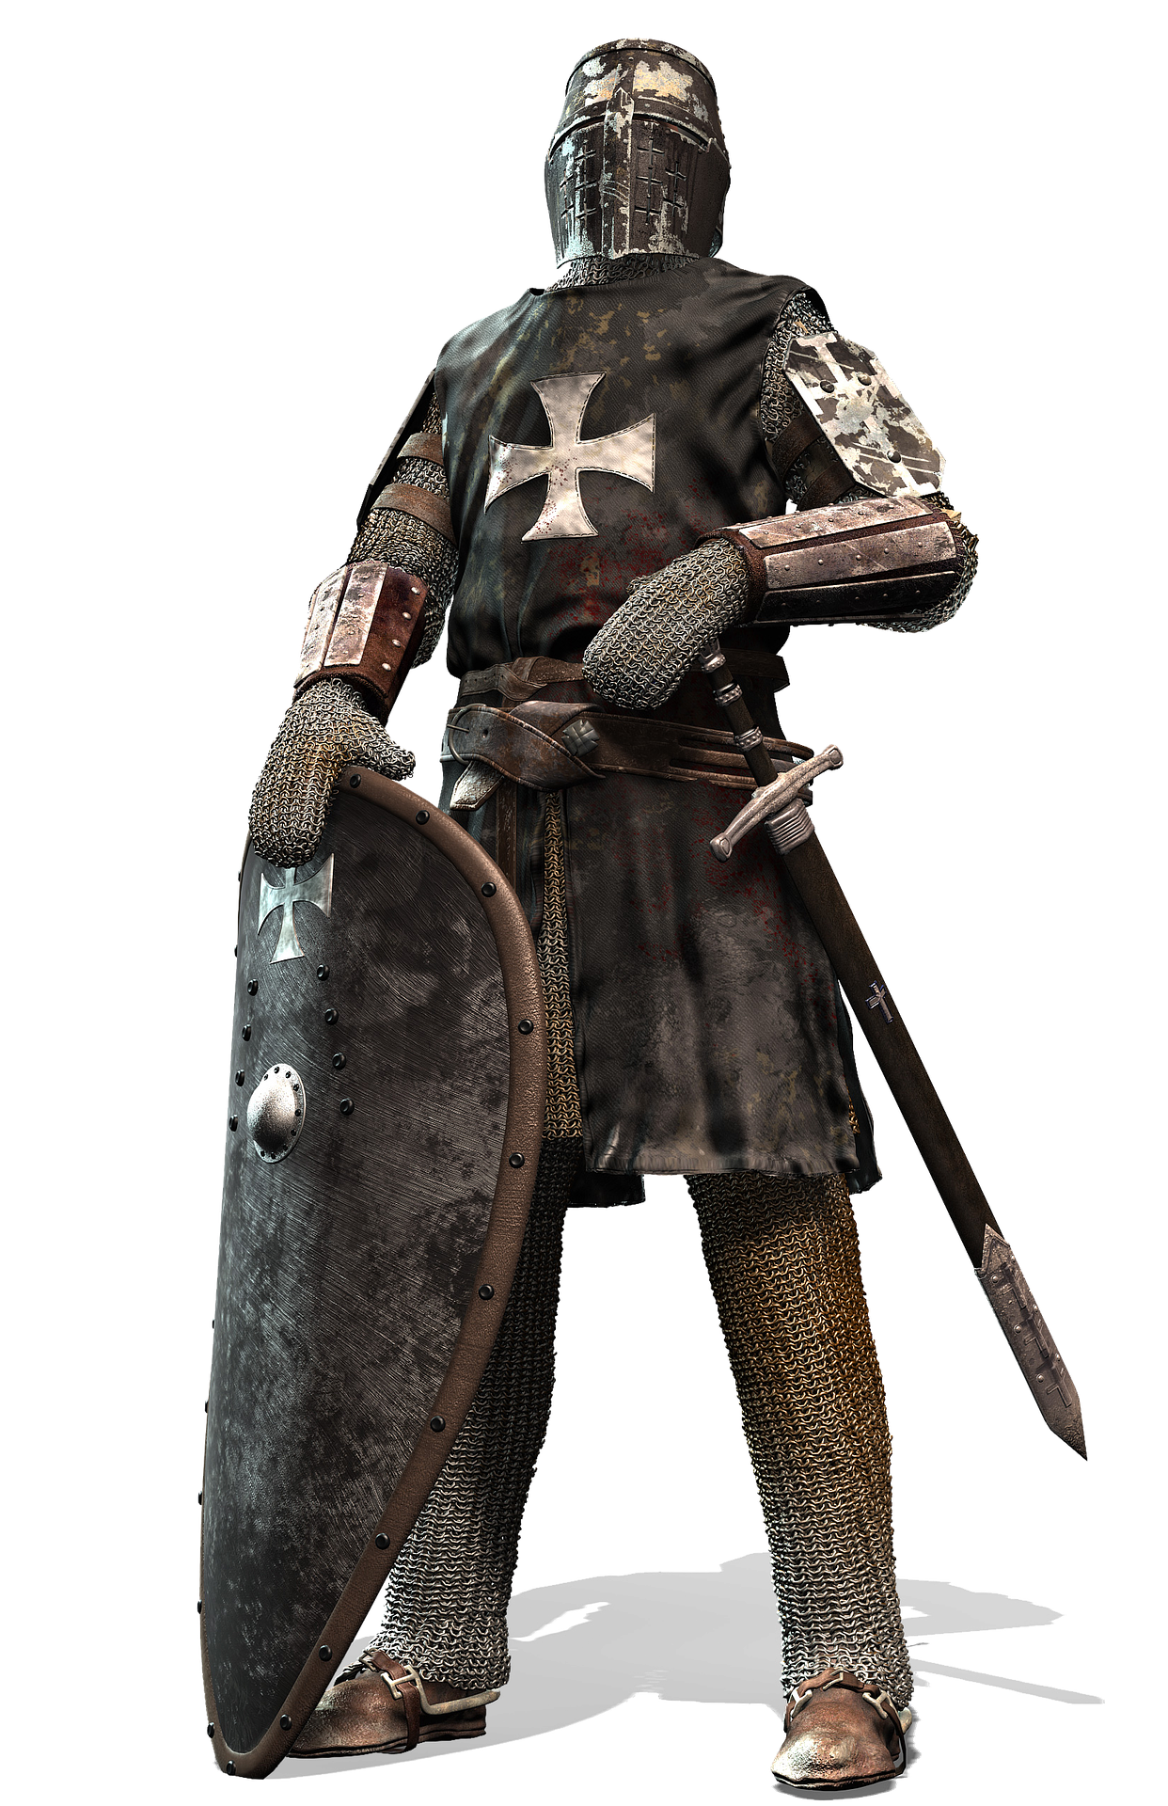
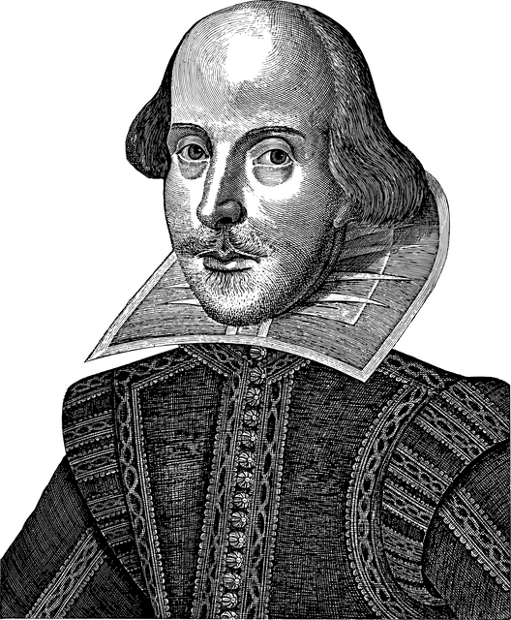
One-dimensional teams
Notes:
Imagine a party of warrior fighters who are all very strong. Could take on the king’s guard with no problem.
<click>
Or a party of charismatic, clever, and witty bards. Not so strong, but could talk their way past the king’s guards with no problem.
There are some challenges each of these teams will excel at. Imagine.
Now, there are many other challenges these teams would have to avoid, or they will fail.
Now imagine you're on an engineering team at NASA. <click>

Slide 16

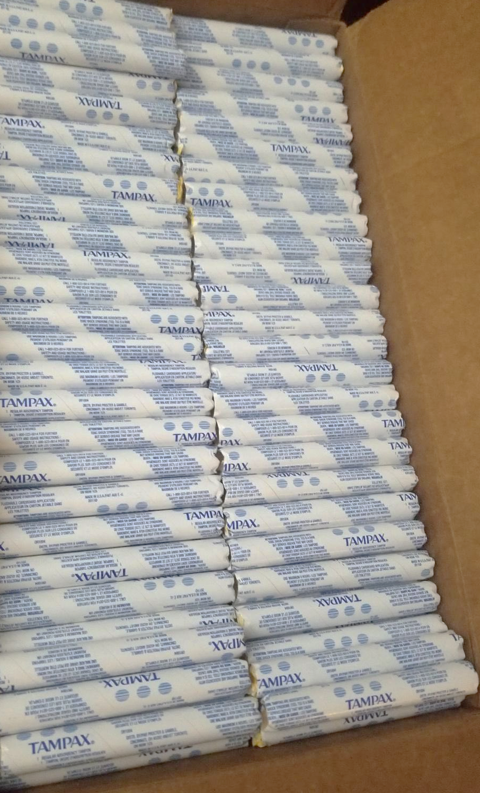
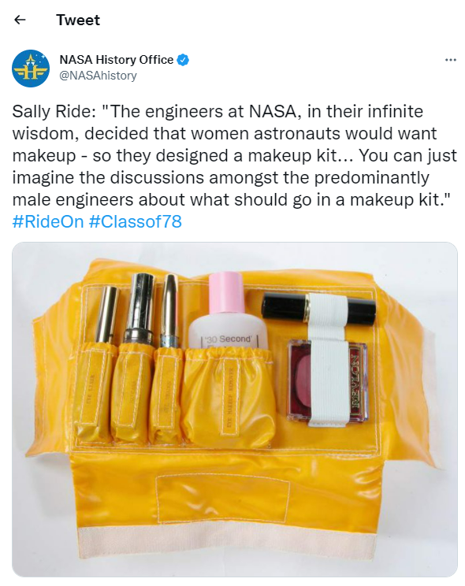

Diverse teams are better at solving problems
Notes:
And this team of NASA engineers is trying to figure out what Sally Ride, the first female shuttle astronaut, would need to bring with her, for 14 days in space.
Looking around the room, you realize the whole team is made up of male engineers.
That very real, very-not-diverse team of NASA engineers guessed – incorrectly - that Ride would need <click>100 tampons for just a 2-week trip and a <click>custom-designed face makeup kit in space. Now imagine what any woman would have told that team of engineers… if only they had the chance. Heck, Katherine Johnson could have told them, and she was down the hall programming the orbital calculations.
In a game, having a party with diverse skills is crucial, for needing to lift the castle's portcullis, or recognize the poison dart trap, or to recognize the mysterious symbols on the wall.
Similarly, a team of developers needs a broad range of talents to create intuitive user experiences. UX developers need different points of view to understand the user flow and journey through a digital experience, to create something that will help others achieve more.

Slide 17
Diversity matters to teams
Playing style
Diversity
Team member diversity
Character skill diversity
Team skillset diversity
Notes:
And hey, that supports one of our core goals at Microsoft – building on the success of others.
At the gaming table and in the workplace, you should aim for a diversity of background, diversity of experience, and diversity of skillsets.
This not only creates a strong group of characters and co-workers, but also helps everyone on the team empathize with customers, ultimately doing better work in the long run.
This is why good companies cast wide nets in recruiting efforts, nets that avoid recruiting exclusively from elite schools, that include nontraditional candidates, candidates skilled through alternative routes, Historically Black Colleges and Universities, career switchers, veterans, international candidates. The best teams have a variety of backgrounds and lived experiences, and are better able to view problems from a variety of lenses, not just the lens of a dominant majority.

Slide 18

“It’s difficult to build technology that serves the world without first building a team that reflects the diversity of the world… A more diverse group of researchers and engineers is more likely to recognize and think harder about bias problems that may even impact them personally.”
Brad Smith, Microsoft President Tools and Weapons (2019)
Notes:
Microsoft’s own President, Brad Smith, wrote in his 2019 book, It’s difficult to build technology that serves the world without first building a team that reflects the diversity of the world… A more diverse group of researchers and engineers is more likely to recognize and think harder about bias problems that may even impact them personally.

Slide 19
Psychological safety in teams and at gaming tables
Feeling included
Crucial to collaborative creation
Often taken for granted by members of the majority
Focus on solutions, not blame
Safety to Challenge and Create
Safety to Learn and Grow
Notes:
A final note on why diversity matters to individuals on teams and at gaming tables.
Psychological safety is crucial.
We talked about this being on Maslow's hierarchy of needs earlier. Psychological safety is a social environment, where everyone feels included and safe to learn, contribute, and create.
Un-inclusive or discriminatory behaviors -- like for example, casual misogyny in jokes -- leads to exclusion, which leads to a lack of psychological safety. And that stifles creativity and productivity. It may mean that someone may weigh their participation against that discomfort, and participate only uncomfortably, if at all. I don't think anyone actively wishes our team members to be uncomfortable when they join us, so it's important to recognize the value they bring to the team and be sure we're welcoming and inclusive.
Psychological safety is one of those things that straight white men may take for granted - in many spaces in my field of information technology, straight white men may take for granted that they'll be in the majority of various social circles. It’s assumed that my performance won’t be a reflection of their gender or my race, whereas a minority may feel these pressures and anxieties.
Of course, it’s possible for anyone to feel they aren’t psychologically safe, depending on the environment, management expectations, interactions with peers.
We won’t spend too much more time here, but for example, your project post-mortems, retroactive meetings, discovery sessions, and troubleshooting root cause analysis should not point fingers.
Focus on solutions instead of blame-storming. This creates an environment where mistakes are safe, where penalties and embarrassment aren’t needed, and where we're free to create and try, we're free to roll a 1 … and instead of bashing the dragon with our axe, we stub our toe. And everyone learns and laughs and has a great story to tell, and we move on.

Slide 20
Practice Empathy
Professional Communication | Teamwork | Team Management | Diversity | Practice Empathy | Q&A
Notes:
<william>
This is why we’ve been talking about empathy in content design, in teams, in teamwork, on the necessity of diverse teams.

Slide 21

Man, we in here talkin about practice
“I know you’ve heard it a thousand times before. But it’s true – hard work pays off. If you want to be good, you have to practice, practice, practice. If you don’t love something, then don’t do it.”
Ray Bradbury
Notes:
[William]
Like we mentioned with public speaking before, like with Toastmasters, practice and learning through experience is necessary before we can create/improvise.
We must take time to learn the rules of D&D before we can play, similarly, have to do the homework before you can master something.
Well, being the Dungeon Master of a D&D game can be part of the hours practice on your way to improving your facilitation of a creative process.
Similarly, a base level of experience is what allows us to practice the empathy-building necessary and guide a group to through a creative process.

Slide 22
Build skills through play
Diversity
Creativity
Collaboration
Digital Transformation
Team Management
Role Playing
Empathy & Diversity
Notes:
[William]
Tabletop Role Playing games allow us to continuously build these skills: creativity, empathy, collaboration, team and meeting management. We learn the value of empathy and diversity.
The skills we have discussed today are the key elements to tabletop roleplaying games as well as a successful career.
The best tabletop players create a character and learn to think as that character. They learn how to feel empathy as someone else. Games teach us how to improve.
We can practice these skills in a safe environment at the gaming table - we can learn, grow, succeed, and even roll a 1 and stub our toe.

Slide 23

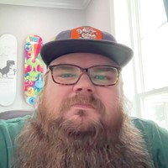

Q&A
Christine Assaf
hrtact.com
@HRTact
linkedin.com/in/christineassaf
Stacy Vicknair
stacyvicknair.com
linkedin.com/in/stacyvicknair
William Assaf
sqltact.com
@William_a_DBA
linkedin.com/in/williamdassaf

Slide 24
U betta have my citations
[STUDY] Hobbies & Work: https://bpspsychub.onlinelibrary.wiley.com/doi/abs/10.1111/joop.12064
[BOOK} Working with Emotional Intelligence by Daniel Goleman: https://www.amazon.com/Working-Emotional-Intelligence-Daniel-Goleman/dp/0553378589
[VIDEO} Daniel Goleman HBR: https://hbr.org/video/2838341939001/leaders-need-three-kinds-of-focus
[BOOK] Developing Management Skills: https://cmls-global.com/wp-content/uploads/2018/02/Developing-Management-Skills-for-Decisions-Making.pdf

